Slide 1
Networking

Slide 2
Basics of Networking
Networking
Concept of connecting two or more computing devices together so that we can share resources.
Java Networking
Java socket programming
It provides facility to share data between different computing devices.
java.net.* package for java network related classes
Advantage of Java Networking
Sharing resources
Centralize software management

Slide 3
Java Networking Terminology
Widely used Java networking terminologies :
IP Address
Protocol
Port Number
MAC Address
Connection-oriented and connection-less protocol
Socket

Slide 4
IP Address
IP address is a unique number assigned to a node of a network.
e.g. 192.168.0.1 .
It is composed of octets that range from 0 to 255.
It is a logical address that can be changed.
Protocol
A protocol is a set of rules basically that is followed for communication.
For example:
TCP, FTP, Telnet, SMTP, POP etc.

Slide 5
Port Number
The port number is used to uniquely identify different applications.
It acts as a communication endpoint between applications.
It is associated with the IP address for communication between two applications.
MAC Address
MAC (Media Access Control)
MAC Address is a unique identifier of NIC (Network Interface Controller).
A network node can have multiple NIC but each with unique MAC.

Slide 6
Connection-oriented and connection-less protocol
In connection-oriented protocol-
Acknowledgement is sent by the receiver.
So it is reliable but slow.
The example is TCP.
In connection-less protocol-
Acknowledgement is not sent by the receiver.
So it is not reliable but fast.
The example is UDP.
Socket
A socket is an endpoint between two way communication.

Slide 7
Java InetAddress class
Java InetAddress class represents an IP address.
The java.net.InetAddress class provides methods to get the IP of any host name.
Example
www.google.com
www.facebook.com

Slide 8
Methods of InetAddress class
public static InetAddress getByName(String host)
it returns the instance of InetAddress containing LocalHost IP and name.
public static InetAddress getLocalHost()
it returns the instance of InetAdddress containing local host name and address.
public String getHostName()
it returns the host name of the IP address.
public String getHostAddress()
it returns the IP address in string format.

Slide 9
import java.io.*;
import java.net.*;
public class Inet{
public static void main(String[] args){
try{
InetAddress ip=InetAddress.getByName("www.google.com");
System.out.println("Host Name: "+ip.getHostName());
System.out.println("IP Address: "+ip.getHostAddress());
}catch(Exception e)
{
System.out.println(e);}
}
}

Slide 10
Output
C:\AOOC\exp14>javac Inet.java
C:\AOOC\exp14>java Inet
Host Name: www.google.com
IP Address: 172.217.163.164
C:\AOOC\exp14>javac Inet.java
C:\AOOC\exp14>java Inet
Host Name: www.facebook.com
IP Address: 31.13.79.35

Slide 11
Socket
A socket is one endpoint of a two-way communication link between two programs running on the network.
A socket is bound to a port number to identify the application to whom data is to be sent.
An endpoint is a combination of an IP address and a port number.
Every TCP connection can be uniquely identified by its two endpoints.
We can have multiple connections between your host and the server.

Slide 12
Socket Programming
Java Socket programming-
Used for communication between the applications running on different JRE.
Can be connection-oriented or connection-less.
Socket used for Client and server programming
Client should know two information:
IP Address of Server
Port number.

Slide 13
Connection-oriented protocol-TCP
In connection-oriented protocol-
Acknowledgement is sent by the receiver.
So it is reliable
It is slow.
Socket programming is connection-oriented
Socket class
ServerSocket class
The java.net package provides a class, Socket
java.net.Socket class

Slide 14
Connection-less protocol-UDP
In connection-less protocol-
Acknowledgement is not sent by the receiver.
It is not reliable
It is fast.
Socket programming is connection-less
DatagramSocket class
DatagramPacket class

Slide 15
Socket class
A socket is simply an endpoint for communications between the machines.
The Socket class can be used to create a socket.
Important methods-
Method | Description
public InputStream getInputStream() | returns the InputStream attached with socket.
public OutputStream getOutputStream() | returns the OutputStream attached with socket.
public synchronized void close() | closes this socket

Slide 16
ServerSocket class
The ServerSocket class can be used to create a server socket.
This object is used to establish communication with the clients.
Important methods
Method | Description
public Socket accept() | returns the socket and establish a connection between server and client.
public synchronized void close() | closes the server socket.

Slide 17
Steps for Client Side Programming
Establish a Socket Connection
To open a socket:
Socket socket = new Socket(“127.0.0.1”, 6000)
Communication
getOutputStream() to send output to the server socket
getInputStream()
Closing the data stream and connection
input.close();
out.close();
socket.close()

Slide 18
Client Side Programming-Writing to a Socket
import java.io.*;
import java.net.*;
public class Client {
public static void main(String[] args) {
try{
Socket s=new Socket("localhost",6000);
DataOutputStream dout=new DataOutputStream(s.getOutputStream());
dout.writeUTF("Hello Server");
dout.close();
s.close();
}catch(Exception e){
System.out.println(e);
} } }

Slide 19
Steps for Server Programming
Establish a Socket Connection
ServerSocket which waits for the client requests (when a client makes a new Socket())
A plain Socket to use for communication with the client (after accepting connection)
Communication
getOutputStream() method to send the output through the socket.
getInputStream() method to receive the input through the socket.
Close the i/o stream and Connection
Close() method.

Slide 20
Server Programming-Reading from a Socket
import java.io.*;
import java.net.*;
public class Server {
public static void main(String[] args){
try{
ServerSocket ss=new ServerSocket(6666);
Socket s=ss.accept();
DataInputStream dis=new DataInputStream(s.getInputStream());
String str=(String)dis.readUTF();
System.out.println("message= "+str);
ss.close();
}catch(Exception e){ System.out.println(e);
} } }

Slide 21
Connection-less protocol-UDP
In connection-less protocol-
Acknowledgement is not sent by the receiver.
It is not reliable
It is fast.
Socket programming is connection-less
DatagramSocket class
DatagramPacket class

Slide 22
Datagrams
Client and server communication via TCP socket.
Dedicated point-to-point channel between them
To communicate, they establish a connection
Transmit the data
Close the connection.
Data sent via channel is received in same order
Guaranteed by the channel.
Acknowledgement is sent

Slide 23
Datagrams
Client and server communication via datagrams.
Send and receive completely independent packets of information.
Connection-less socket for sending and receiving
Do not have dedicated point-to-point channel.
Delivery of datagrams is not guaranteed.
Order of their arrival is not same.
Arrival time not same
No acknowledgement is sent.

Slide 24
What is Datagram?
A datagram is
An independent, self-contained message sent over the network whose
Arrival, arrival time, and content are not guaranteed.
Bundles of information passed between machines.
No assurance that it will arrive after sending
No assurance that someone will be catch it.
No response to sender.
Java implements datagrams on top of the UDP
Implements datagrams using DatagramSocket and DatagramPacket class

Slide 25
DatagramSocket
DatagramSocket
Mechanism used to send or receive the datagram packets.
Class represents a connection-less socket.
Constructors of DatagramSocket class
DatagramSocket() throws SocketException
DatagramSocket(int port) throws SocketException
DatagramSocket(int port, InetAddress address)

Slide 26
Constructors of DatagramSocket class
Constructors | Description
DatagramSocket() | it creates a datagram socket and binds it with the available Port Number on the localhost machine.
DatagramSocket(int port) | it creates a datagram socket and binds it with the given Port Number.
DatagramSocket(int port, InetAddress address) | it creates a datagram socket and binds it with the specified port number and host address.

Slide 27
DatagramPacket class
DatagramPacket
Message that can be sent or received.
send multiple packet, it may arrive in any order.
Packet delivery is not guaranteed.
Object is the data container
Constructors of DatagramPacket class
DatagramPacket(byte[] barr, int length) | it creates a datagram packet. used to receive the packets.
DatagramPacket(byte[] barr, int length, InetAddress address, int port) | it creates a datagram packet. used to send the packets.

Slide 28
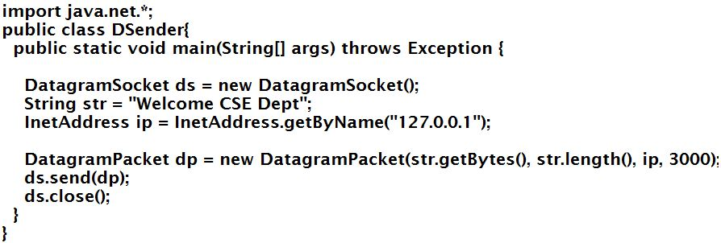
Sending DatagramPacket by DatagramSocket

Slide 29
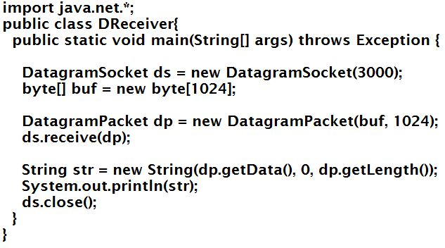
Receiving DatagramPacket by DatagramSocket

